Slide 1
Digital Portfolio
STUDENT NAME: PRIYADATHA M
REGISTER NO AND NMID: 2422K2355
DEPARTMENT: BSC COMPUTER SCIENCE
COLLEGE: JCT COLLEGE OF ARTS AND SCIENCE/BHARATHIAR UNIVERSITY

Slide 2
PROJECT TITLE "Single Page Portfolio Website using HTML, CSS, and JavaScript" "One-File Personal Portfolio for Beginners" "Responsive Portfolio Website Using Basic Web Technologies" "Minimalist Developer Portfolio – All in One HTML File" "Static Portfolio Website with Form and Navigation" "Beginner-Friendly Web Portfolio (HTML/CSS/JS)" "Simple Portfolio Website without Frameworks"

Slide 3


AGENDA
Problem Statement
Project Overview
End Users
Tools and Technologies
Portfolio design and Layout
Features and Functionality
Results and Screenshots
Conclusion
Github Link
3/21/2024 Annual Review

Slide 4

PROBLEM STATEMENT In today’s digital world, having a personal portfolio is important for students, job seekers, and developers. However, many beginners struggle to create one because most tutorials involve complex frameworks or multiple files. This project solves that problem by offering a simple, easy-to-understand portfolio made using just HTML, CSS, and JavaScript, all within a single file. It allows users to quickly build and showcase their work without needing advanced coding knowledge.

Slide 5

PROJECT OVERVIEW This project is a single-page portfolio website designed to be simple, clean, and easy to use. It is created using basic web technologies like HTML for structure, CSS for styling, and JavaScript for basic interactivity. The portfolio includes sections such as About Me, Projects, Contact Form, and more. All content and code are placed within one HTML file, making it easier for beginners to understand, copy, and modify. It serves as a quick way to present skills, projects, and contact information.

Slide 6

WHO ARE THE END USERS? The main users of this project are students, beginners, and anyone who wants to quickly create a personal portfolio. It is especially helpful for those who are learning web development and want to apply their knowledge in a real-world project. Freelancers, job applicants, or participants in hackathons can also use this type of portfolio to present their work in a professional format without spending a lot of time setting up complex environments.

Slide 7

TOOLS AND TECHNIQUES The main users of this project are students, beginners, and anyone who wants to quickly create a personal portfolio. It is especially helpful for those who are learning web development and want to apply their knowledge in a real-world project. Freelancers, job applicants, or participants in hackathons can also use this type of portfolio to present their work in a professional format without spending a lot of time setting up complex environments.

Slide 8
POTFOLIO DESIGN AND LAYOUT
The main users of this project are students, beginners, and anyone who wants to quickly create a personal portfolio. It is especially helpful for those who are learning web development and want to apply their knowledge in a real-world project. Freelancers, job applicants, or participants in hackathons can also use this type of portfolio to present their work in a professional format without spending a lot of time setting up complex environments.
8

Slide 9
FEATURES AND FUNCTIONALITY This portfolio includes basic yet useful features. Navigation links at the top allow users to jump to different sections of the page smoothly. A contact form is included where users can enter their name, email, and message, and it validates inputs using JavaScript. There’s also space to list projects, display screenshots, and include a GitHub link. All of this is done using a single HTML file, making it convenient to deploy or submit as part of an academic or professional project.

Slide 10
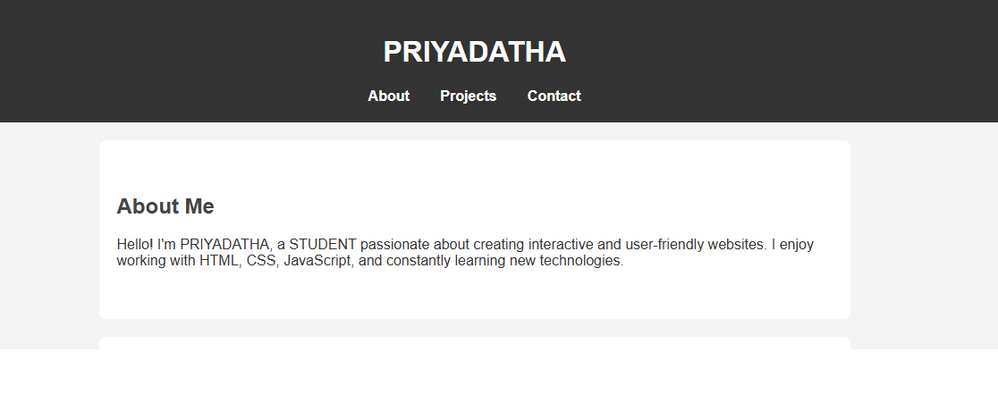

RESULTS AND SCREENSHOTS
3/21/2024 Annual Review
10

Slide 11
CONCLUSION In conclusion, this project successfully demonstrates how a complete, clean, and responsive portfolio can be built using just HTML, CSS, and JavaScript. It is easy to understand, modify, and expand, which makes it perfect for learners or anyone short on time. It proves that you don’t always need complicated tools or frameworks to create something meaningful and useful. This portfolio can be used as a template for future projects or professional presentations.
11

